Slide 1

Croatia/Požega
Created by: Marko Bagarić

Slide 2
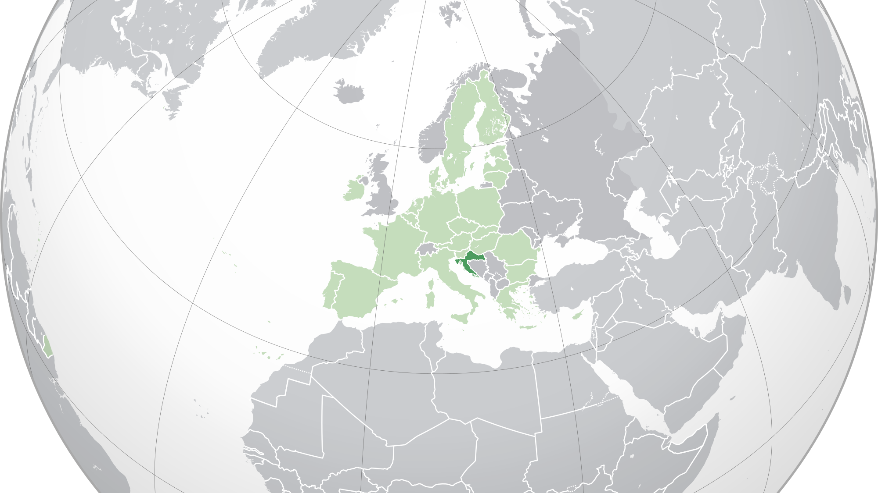

Slide 3
The Republic of Croatia
Republika Hrvatska
3,855,000 people – 2022 estimate
Capital City – Zagreb
Currency – Euro (€)
GPD per capita – $23,000
Independence – 1991
Joined NATO – 2009
Joined the European Union – 2013

Slide 4
Croatia – Full of life
https://www.youtube.com/watch?v=lrvoreqJvV0&ab_channel=CroatiaFullOflife
https://www.youtube.com/watch?v=OpaUcPKrFk8&ab_channel=CroatiaFullOflife

Slide 5
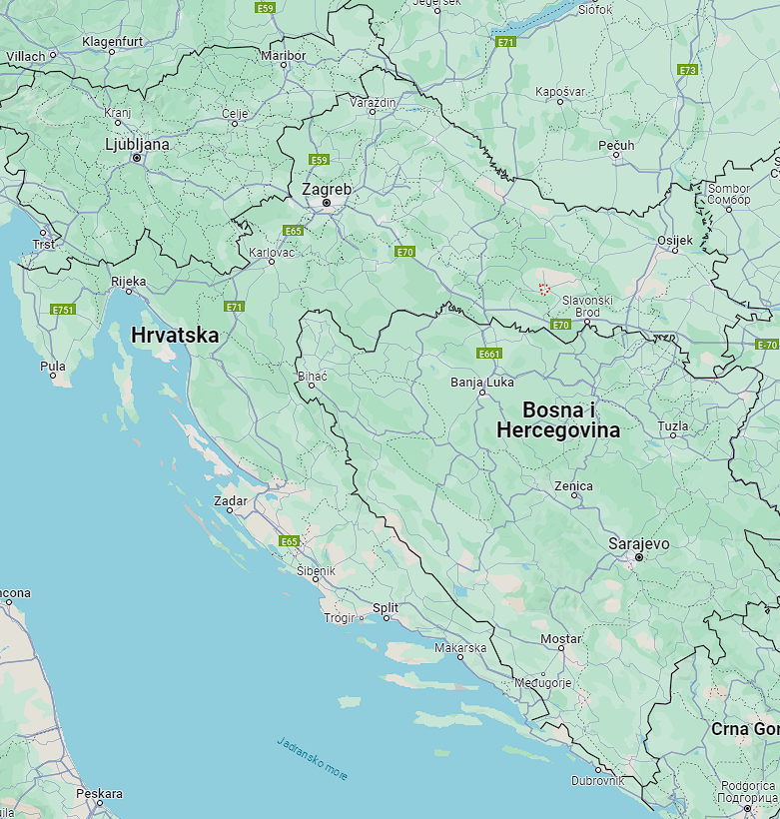
Požega
Golden Valley – heart of Slavonia
23,000 inhabitants
https://www.youtube.com/watch?v=dVwSsqJ-aTE&ab_channel=VisitPo%C5%BEega
https://www.youtube.com/watch?v=FemukYN94Ms&ab_channel=PointersTravel

Slide 6


